Slide 1

A “Peak” into Walmart Sales:
How to Maximize Business Profit
By: Elizabeth Driskill, Mariah Hurt, Arti Patel, and Sania Rasheed
Notes:
Sania
Walmart is one of the leading brands in the world today. We decided to do our project on Walmart Sales so we could investigate how to maximize business profit.

Slide 2
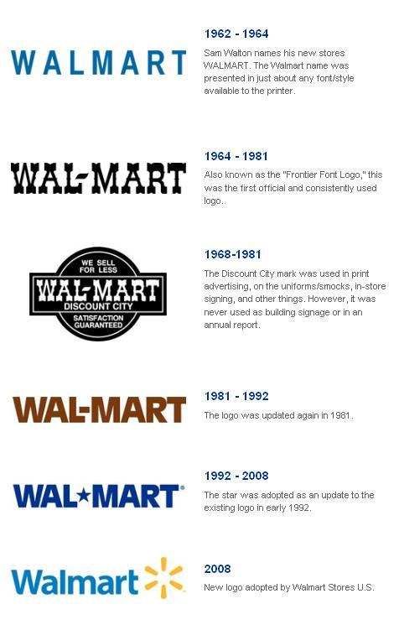


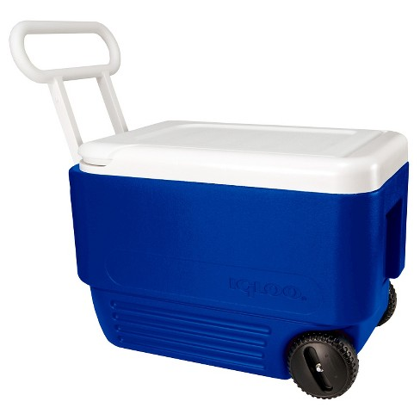
A Brief Introduction
Notes:
Sania
On July 2, 1962, Sam Walton opens the first Walmart store in Rogers, Arkansas.
The Walmart logo has changed 6 times with the post recent logo pictured above.
Walmarts revenue for 2019 is around 514 billion (an increase of 2.8% form 2018)
Is the most profitable retailer in the United States from 1988 till this day .
In 2018, the top selling Walmart product in Virginia was a cooler.
Walmart loses 3 Billion dollars annually to theft
Sania

Slide 3
Our Goal
What suggestions could we provide to Walmart executives about how they should move forward with their company, and what sales tactics should they use?
Notes:
Sania

Slide 4
Our Data Set
Data obtained from Kaggle.com
Consisted of 5 different CSV files
We used 2 out of the 5:
Features CSV
Training CSV
Variables within Features CSV
Store
Date
Temperature
Fuel Price
Markdowns
Consumer Price Index (CPI)
Unemployment
IsHoliday
Variables within Training CSV
Store
Department
Date
Weekly Sales
IsHoliday
Notes:
Sania

Slide 5
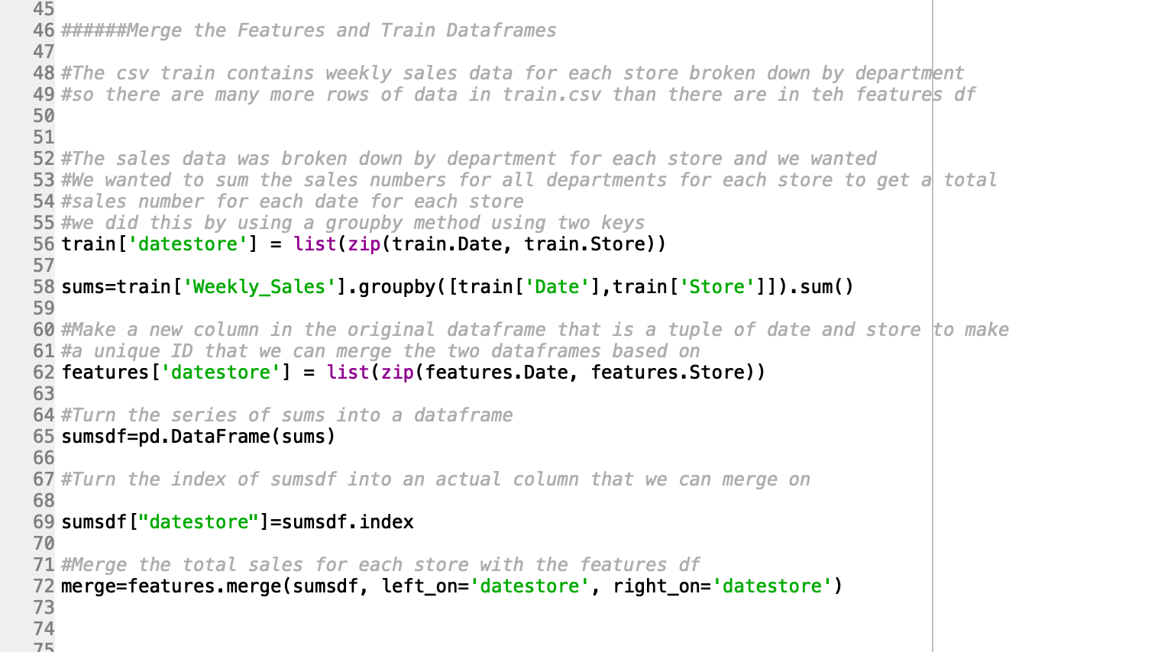
Data Pre-Processing
Notes:
Mariah
Created a new column that was an identifier date+store number in the train dataframe
So that we used the groupby function to sum the weekly sales data for each week for each store
We made the same identifier column date+store in the features dataframe so that we would have a matching col to merge on
The data+store identifier was the index and not a col in the sumsdf so we changed it to be an actual column
Then we used the merge function so that each week for each store would have a sum of the weekly sales

Slide 6
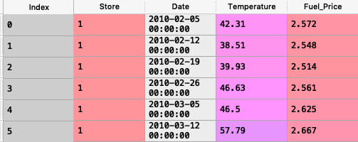
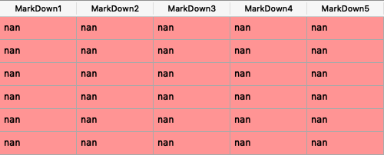
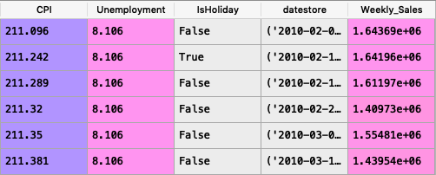
Merged Data
Notes:
Elizabeth
Here you can see the first 6 rows of our final merged data frame.
The columns include index, store number, date, temperature in Fahrenheit, fuel price in USD, 5 MarkDowns, consumer price index, unemployment rate, whether or not the week is a holiday, datestore (which is what we used to merge the two data frames), and weekly sales, also in USD.
We were mainly interested in analyzing trends in weekly sales, specifically how they may be affected by temperature, fuel price, unemployment rates, and holidays.
It should be noted that each of the MarkDown columns included many “NA” values. However, we did not use the information in these columns in our analysis, so these missing values did not affect our final conclusions, and we did not need to exclude any rows from our data frame.
Our last step in cleaning the data was to convert the type of the Date column to be read as a date with the format Year-Month-Day, and then we were able to start data analysis.

Slide 7
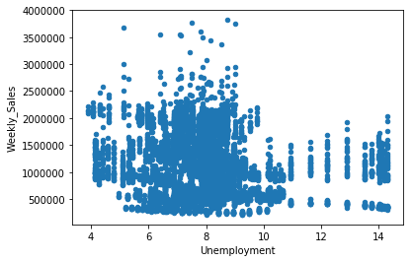
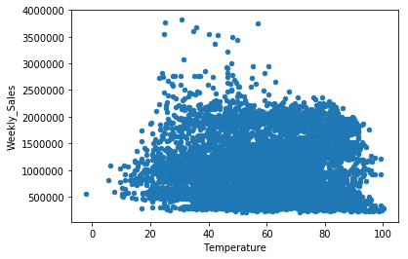
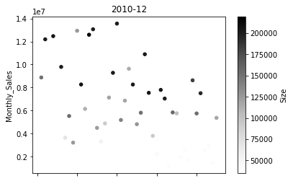
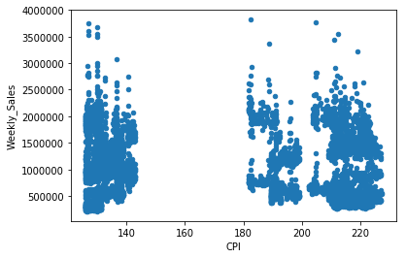
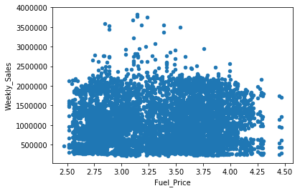
Initial Exploration
Unemployment, temperature, CPI and fuel price vs. weekly sales
One snapshot in time: monthly sales vs store with color representing size of store
Notes:
Arti
Since one of our goals is to find the main factors of sales, we worked with the data we had to see what effects they had on store sales.
Major shift in unemployment shows negative correlation between unemployment rate and weekly sales
Sales tend to peak when temperature is just right - between 40-60 degrees - this could also be holiday season (December)
CPI doesn’t say much - not enough time to show a trend
On the one hand, lower fuel prices should indicate higher sales, but the lowest prices (below 3.25) are post ‘08 crisis, so makes sense that sales stay low since low demand for consumer goods. Makes sense that higher fuel prices correlate with lower sales, since this leaves consumer with less discretionary spending
Snapshot in time shows larger stores almost always have higher monthly sales

Slide 8
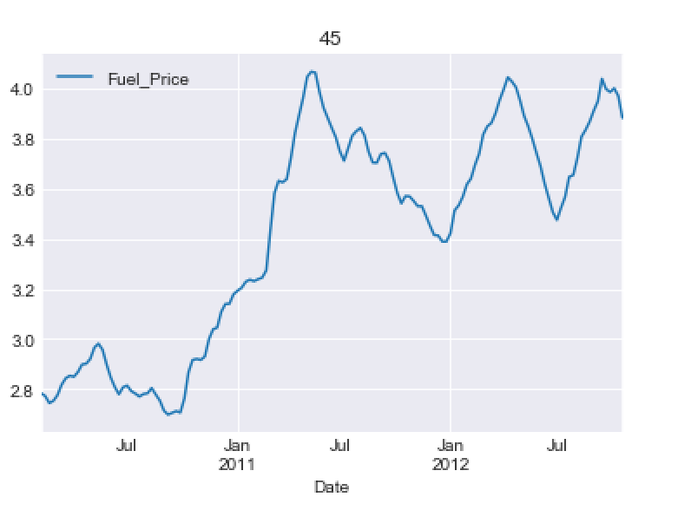
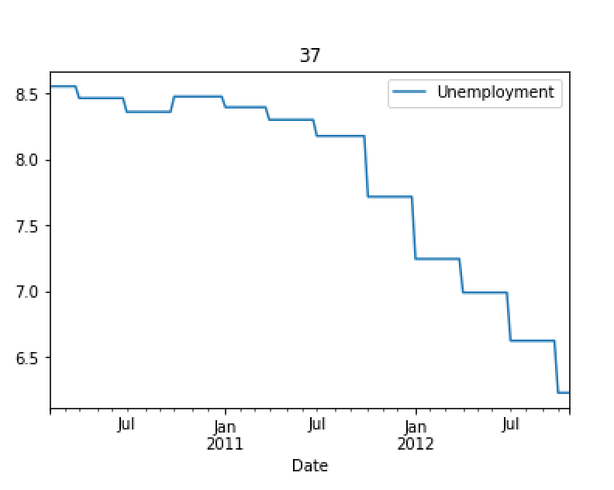
Fuel Price, Unemployment over Time
Fuel price paring from deflation of ‘08 crisis
Unemployment decreasing over time after ‘08 crisis
Notes:
Arti
Fuel price starting to pare from ‘08 crisis after mid 2011, then cyclical patterns
Same story with unemployment, we see that around the same time unemployment gradually decreases
Whether this has a wholistic effect on every store doesn’t apply

Slide 9
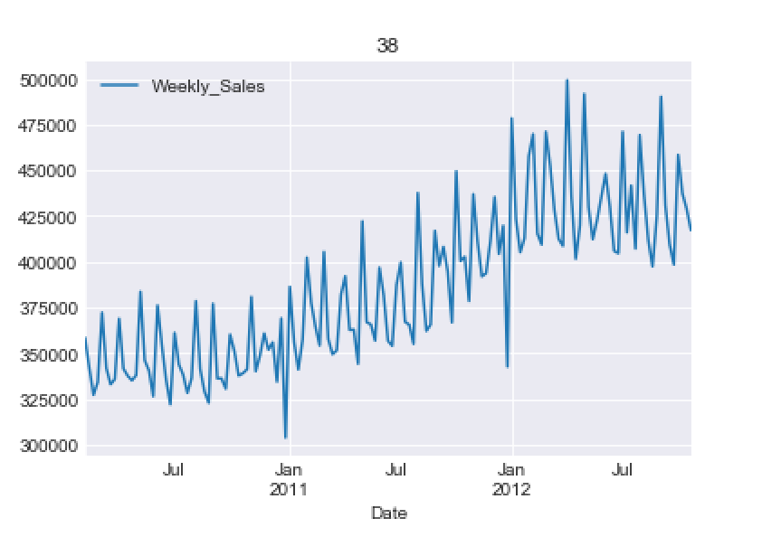
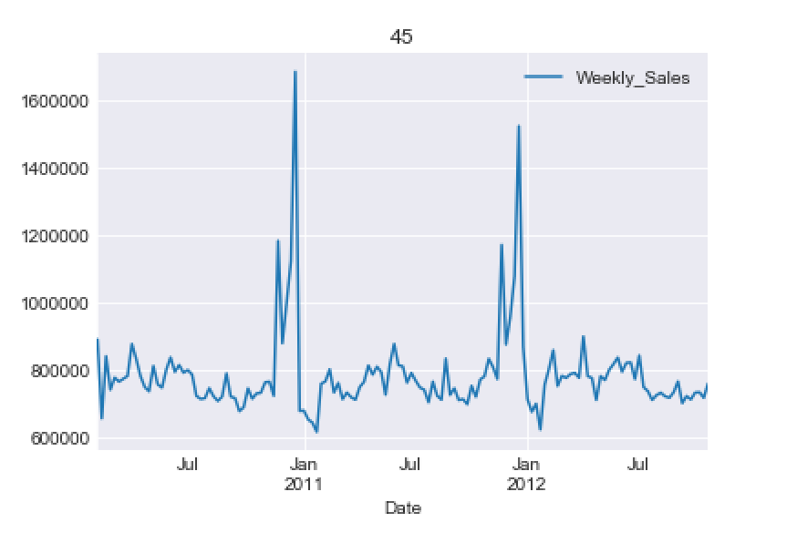
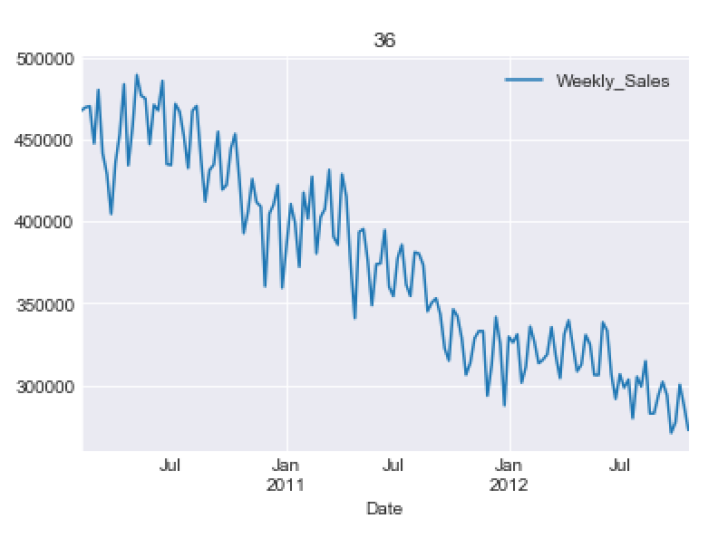
Weekly Sales vs Time for Stores 38, 45, 36
Steadily increasing over time
Most common trends
Peaks around winter holiday season
Steadily decreasing over time
Notes:
Mariah
We plotted weekly sales over time for all 45 stores
The plot in the middle is characteristic of what we saw, almost all stores were like this
Seasonal holiday peaks in December that we think are associated with Chistmas shopping
The store on the left curiously lacks any seasonal peaks, it steadily increases- why?
The store on the right curiously lacks any peaks and is heading down - why? Maybe we should close it?

Slide 10
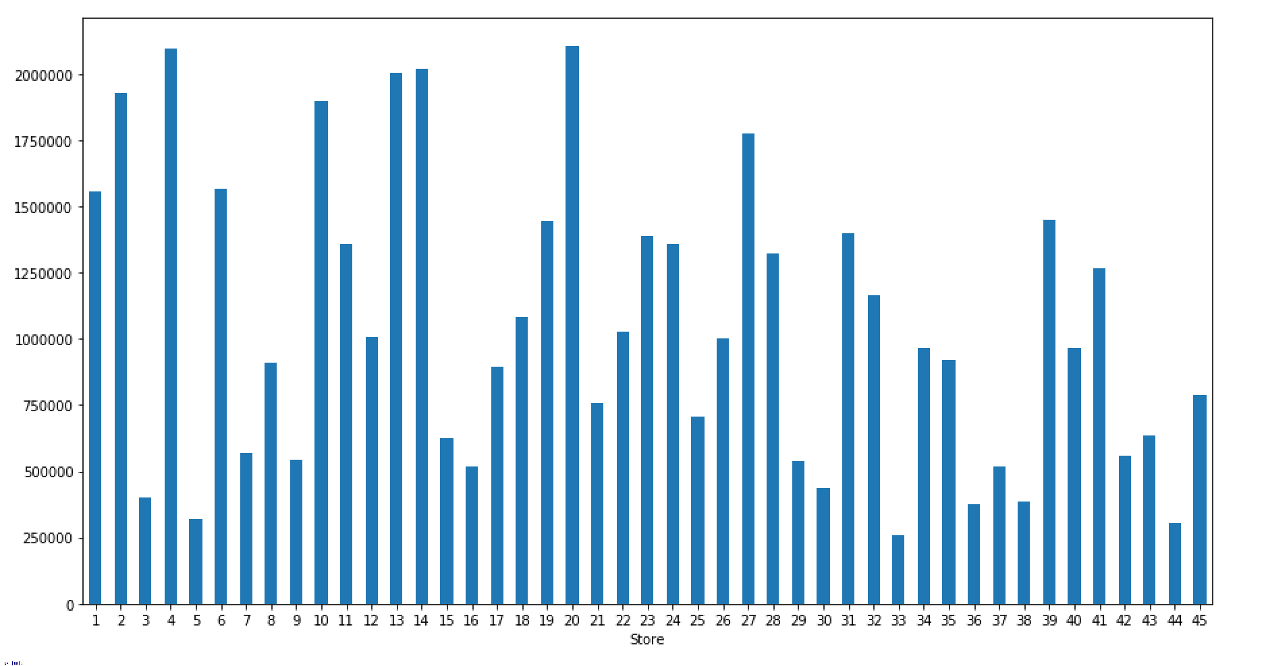
Weekly Sales for All Stores
Weekly Sales vary widely across the 45 stores
Stores 36, 38 and 45
appear to have similar averages
however, figures in previous slides reveal patterns over time
Notes:
Mariah
We created several functions in our code to calculate different things about each store
We calculated average weekly sales over the two years
The three stores we previously looked at have similar averages but very different patterns
These wide differences in average sales were not well described by fuel price, or unemployment
It would be inteesting to look at geo location, population, and store size (is it a super walmart w/ a grocery store?)

Slide 11
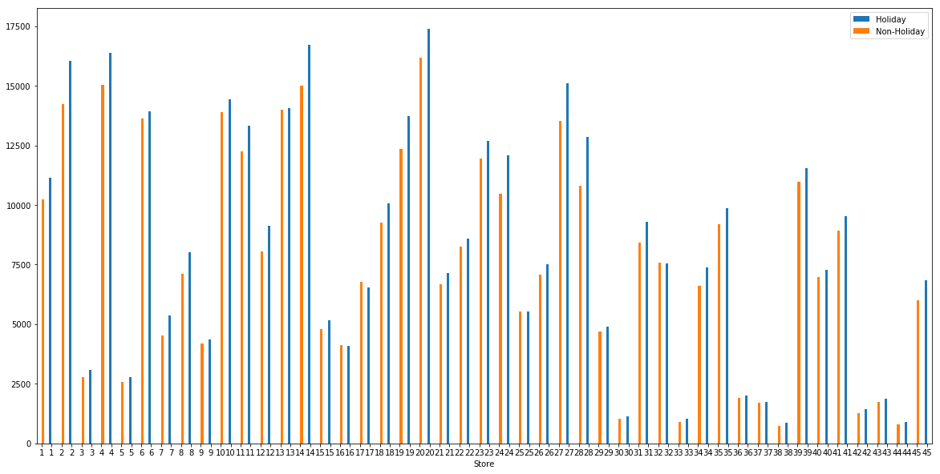
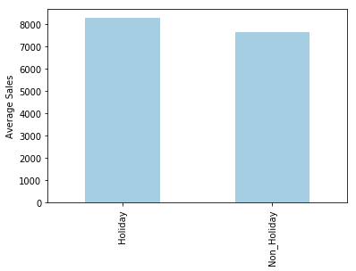
Comparing Effects of a Holiday on Sales
Average sales overall on Holidays vs. Non-Holidays
Holiday vs Non-Holiday for each of the 45 stores
Notes:
Elizabeth
We created a separate data frame that contained the median weekly sales for each store during holiday vs. non-holiday weeks.
We wanted to determine how sales changed during holidays so that we could offer a better suggestion to the company about how they should approach their marketing and sales tactics during these times.
The bar graph on the left shows the median weekly sales for each store during holiday seasons (blue) vs. non-holiday seasons (orange).
For the majority of stores, sales increased if the week was a holiday compared to when it was not.
The bar graph on the right has the average of the median weekly sales across all stores during holiday vs. non-holiday seasons. As expected, the average of the median weekly sales was higher for holiday seasons as compared to non-holiday seasons.

Slide 12
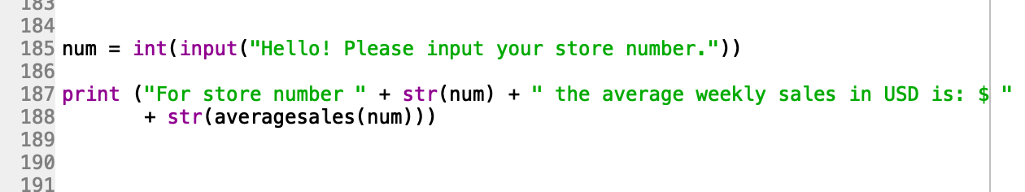
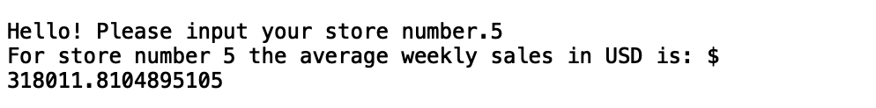
Beyond the Original Specifications
Notes:
Elizabeth
We thought that a useful application of our data analysis would be to create an interface that allows a user to input a specific store that they are interested in and compute the average weekly sales for that store.
This provides the user with an opportunity to compare different stores to each other and potentially gain valuable insight into how each store is performing.
This could be especially useful to Walmart executives in determining which stores might need extra financial resources or which stores might be at risk for going out of business.

Slide 13
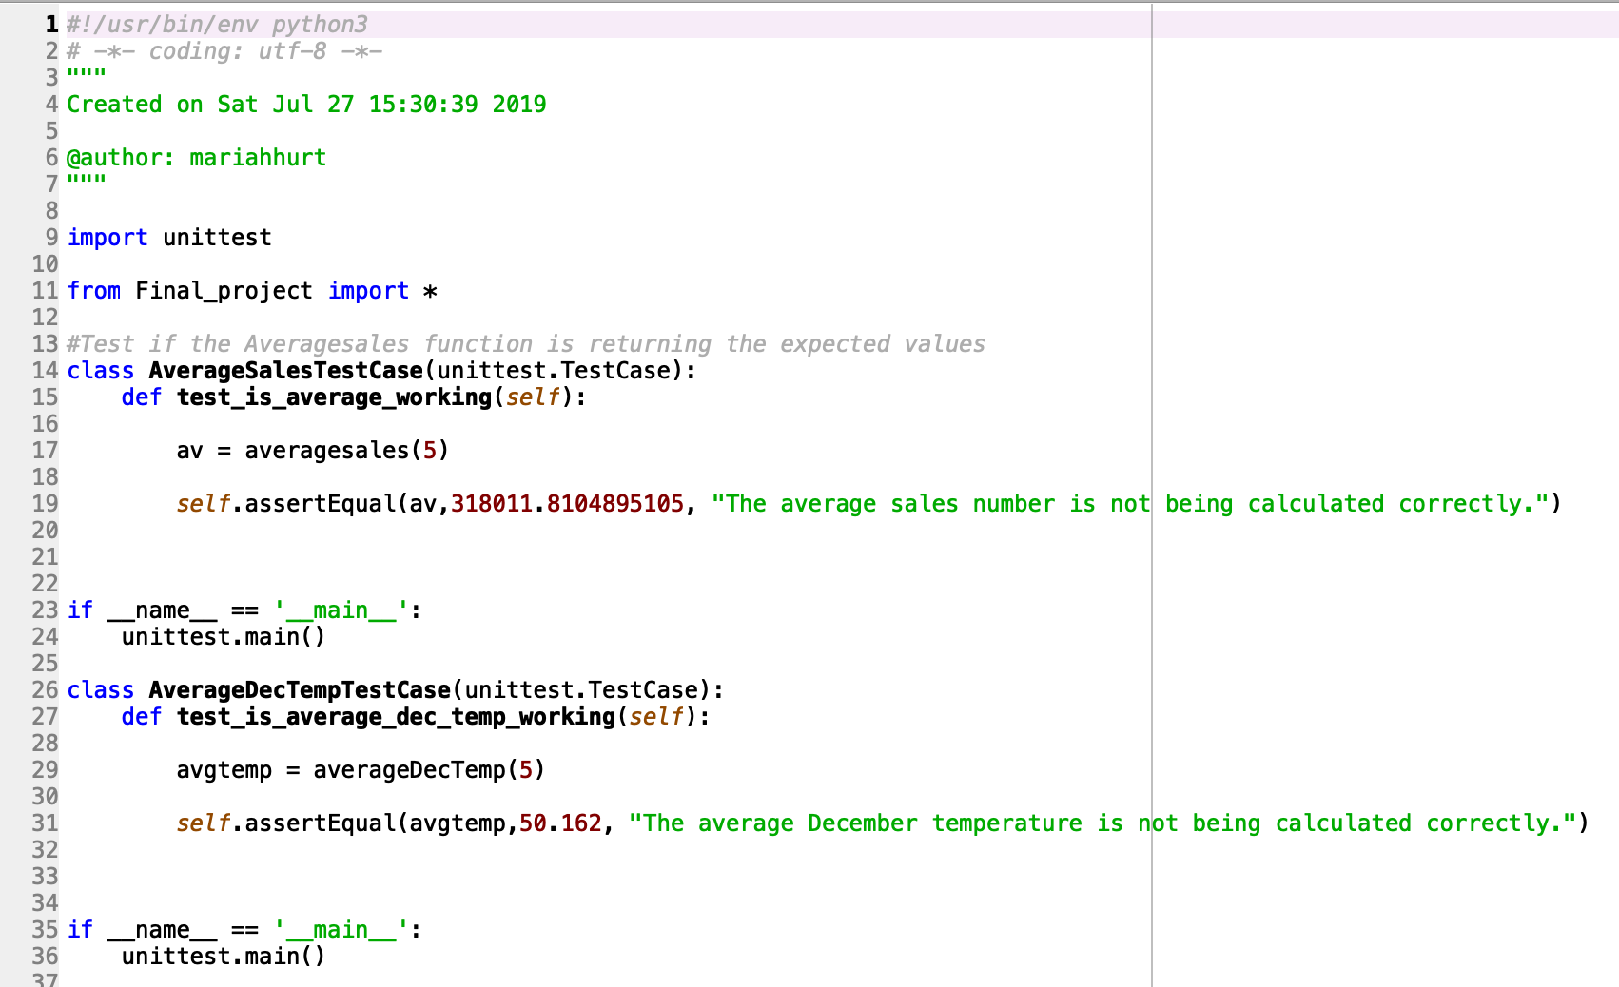
Testing
Notes:
Sania
For the testing portion of our project, we first used the head and tail functions to ensure that our data was read in correctly and looked similar to the csv files.
After merging the data, we also checked that our new data frame had the correct number of rows.
Finally, we wrote unit tests for both of our functions, average sales and average December temperature. Both of these tests passed, so we concluded that the functions were working properly

Slide 14


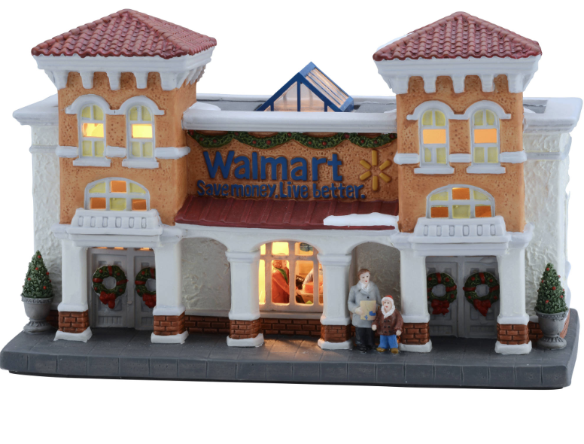
Conclusions
Sales spike around winter holidays for most stores
Increase advertising
Use similar sales tactics during other holidays
Stores that show abnormal sales patterns should be further examined
Store number 38
Store number 36
Notes:
Elizabeth
Many stores showed an increase in sales around the winter holiday season as well as an increase in sales during other holiday weeks.
Given this information, we would recommend to Walmart executives to allocate more funding towards advertising or other recruiting events during the winter holiday season, as this is typically the time of the year when they experience the greatest increase in sales.
They could also look into applying the sales tactics that they incorporate during the winter holiday season to other holiday weeks, such as Halloween, Easter, and the 4th of July in an attempt to increase sales during these weeks as well.
We were also able to determine which stores showed abnormal trends in weekly sales.
Store number 38 showed a steady increase in weekly sales, so it might be a helpful reference to use as an example for stores that are not performing as well.
Store number 36 exhibited a steady decrease in weekly sales over time. Walmart may want to think about closing this store or incorporating new management and sales tactics in order to reverse the downward trend.

Slide 15
Limitations and Further Applications
Our data was limited on details of the location of the store or of the town/city it was located in, sales can be affected by local factors/trends
Our data was also limited by time, it only spanned over two years, while major trends of the economy span over several years
Sales predictions are hard to make over something that cannot be quantified: a store could be doing well because of good management that invests and supports their employees
Notes:
Arti

